Slide 1
Welcome to Narcoossee Middle School

Slide 2
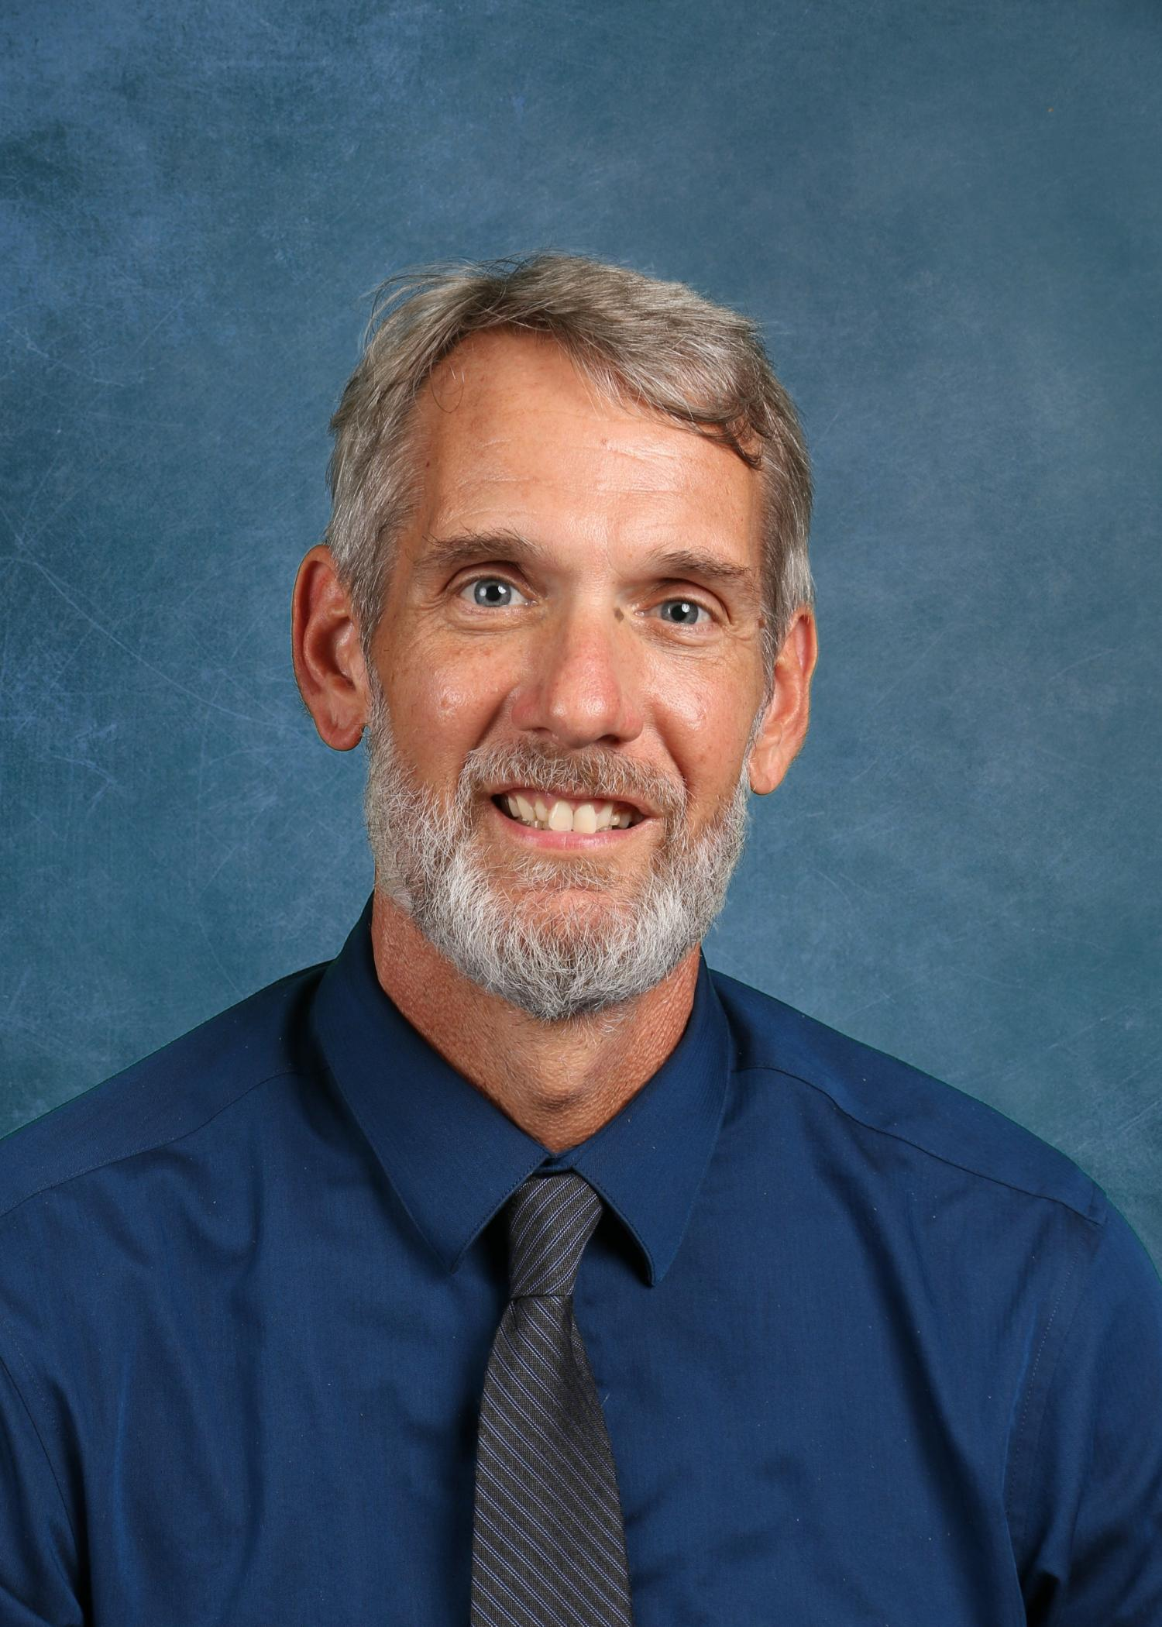
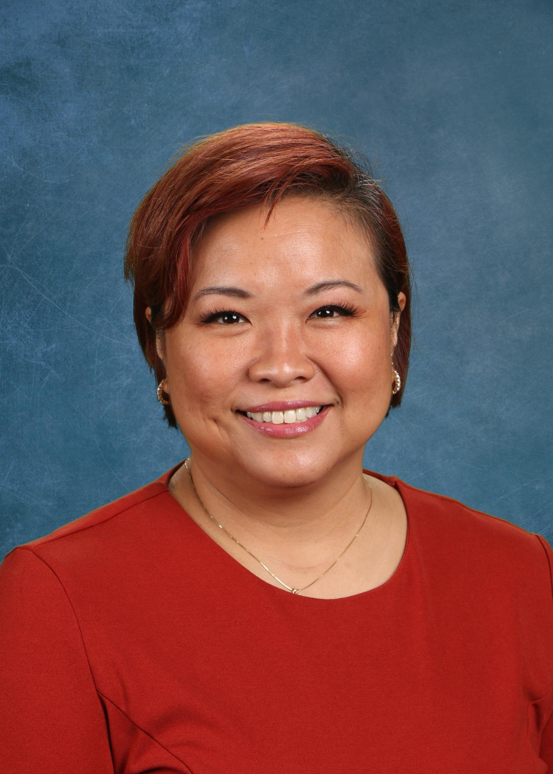
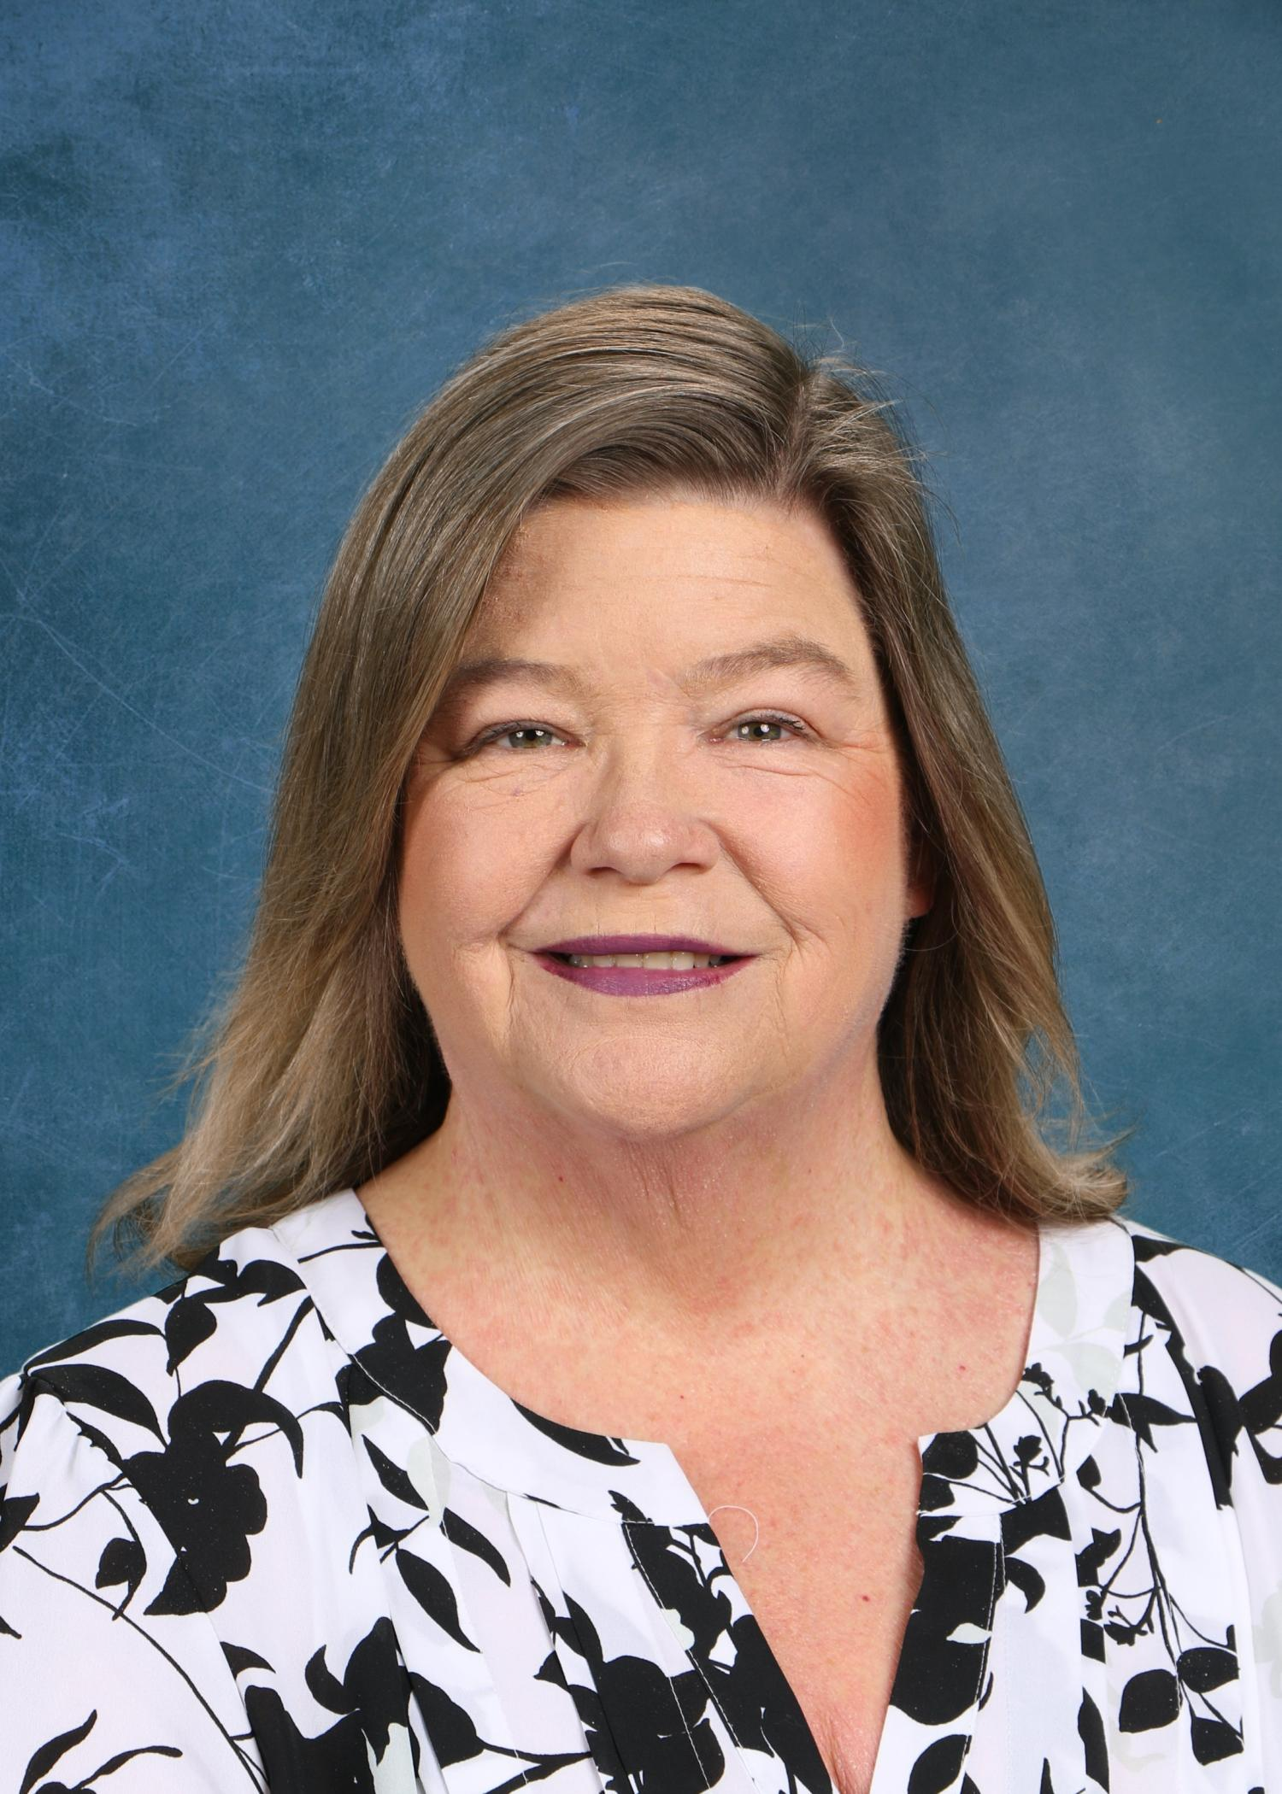
NCMS Administration
Mr. Weeden
Principal
Mrs. Mabra
Assistant Principal
Mrs. Schneider
Assistant Principal

Slide 3

PBIS – BEARS Expectations
We are proud to be a PBIS School!
  Positive Behavior Interventions and Supports
NCMS Bears know, understand, and live the following expectations
  B – Be Responsible
  E – Encourage Others
  A – Act Safely
  R – Respect All
  S – Strive for Success

Slide 4
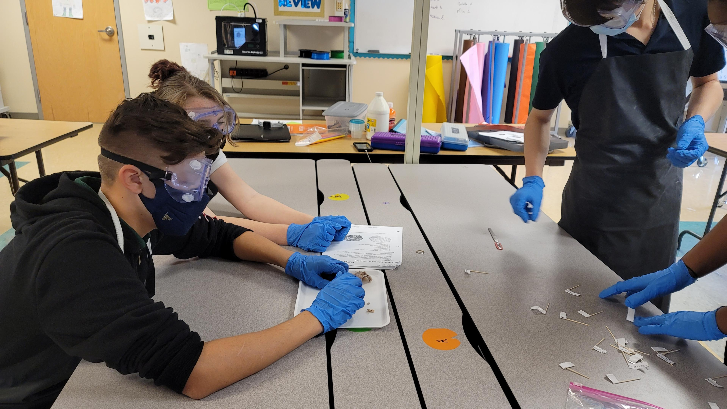
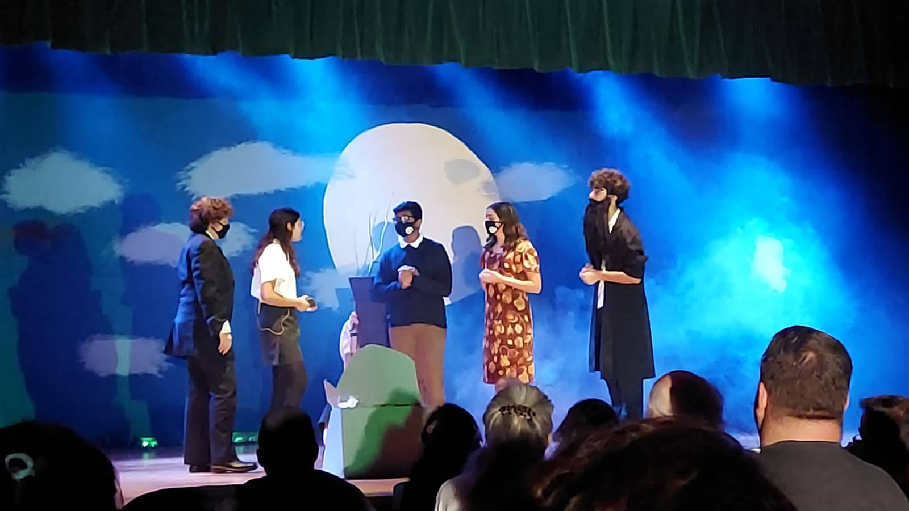
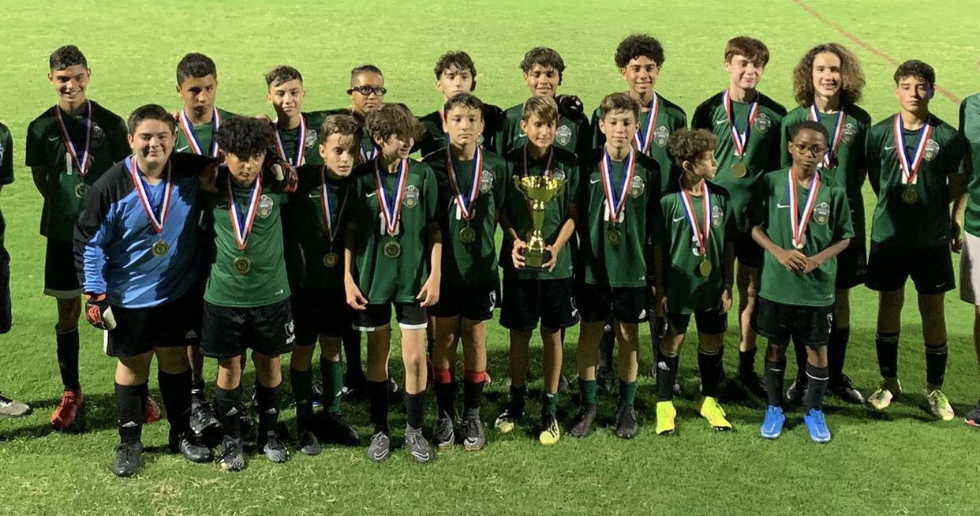
We are Narcoossee!
Great Place to Grow and Learn
Academics + Arts + Athletics = Successful and Well-Rounded Black Bear
AVID National Demonstration School

Slide 5
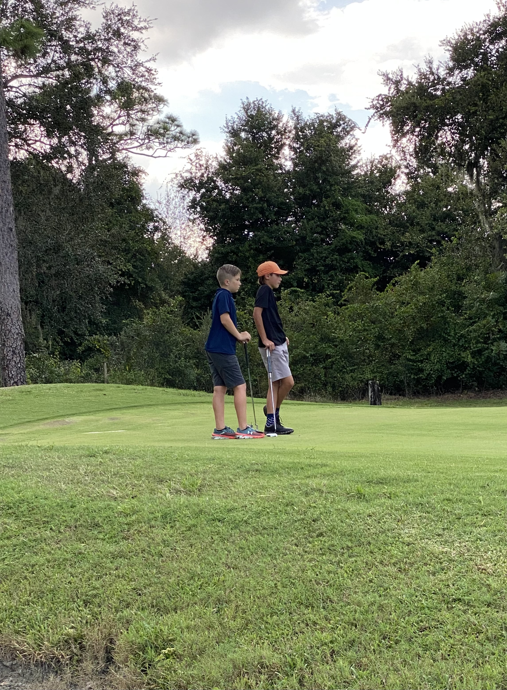
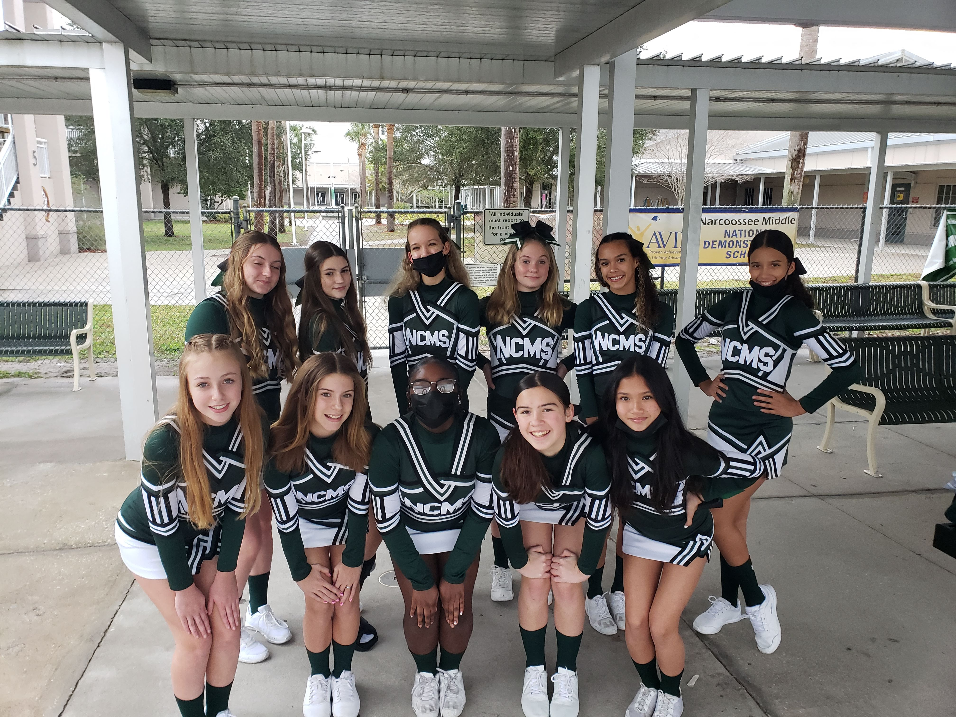
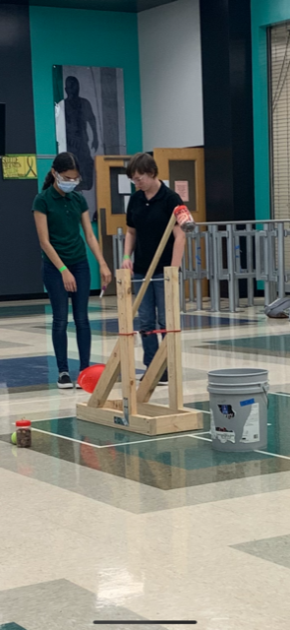
Extra Curricular Activities
Competitive Sports
Clubs
  Basketball
  Cheerleading
  Cross-Country
  Flag Football
  Golf
  Soccer
  Softball
  Track and Field
  Volleyball
  Battle of the Books
  Fellowship of Christian Athletes
  Odyssey of the Mind
  Robotics
  Science Olympiad

Slide 6
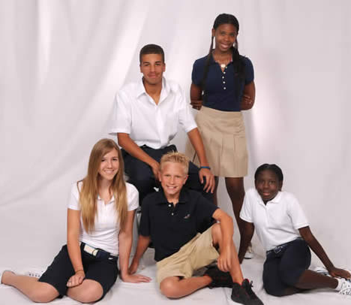
Dress Code
NCMS follows and adheres to the expectations in the School District of Osceola County’s Code of Student Conduct
Polo Colors
  Hunter Green
  Black
  Light Pink
  White
  Navy Blue
Bottoms
  Dark Blue, Black, Khaki
  Denim (Jeans), Twill, Corduroy
Shoes
  Athletic shoes only
  Closed Toe/Heel
Outerwear
  Button-up or zippered

Slide 7
Your Personal School Schedule
  Core classes which include Language Arts, Math, Reading, Science, and Social Studies are scheduled first and are based on assessment scores and teacher recommendations.
  Electives are scheduled for students after core classes have been placed into the schedule. Student elective choices are a request and are not guaranteed.

Slide 8

An Example of a Finalized Schedule
  1st Reading (Research, Intensive Reading or AVID)
  2nd Language Arts (Lang Arts 1, Adv)
  3^{rd Elective 1}
  4^{th Math (Math, Adv)}
  5^{th Lunch}
  6^{th Science (Earth Sci, Adv)}
  7^{th Elective 2}
  8th Social Studies (World History, Adv or US History, Adv)

Slide 9
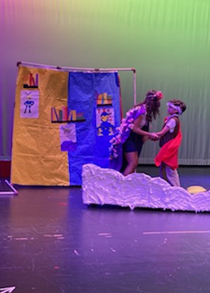
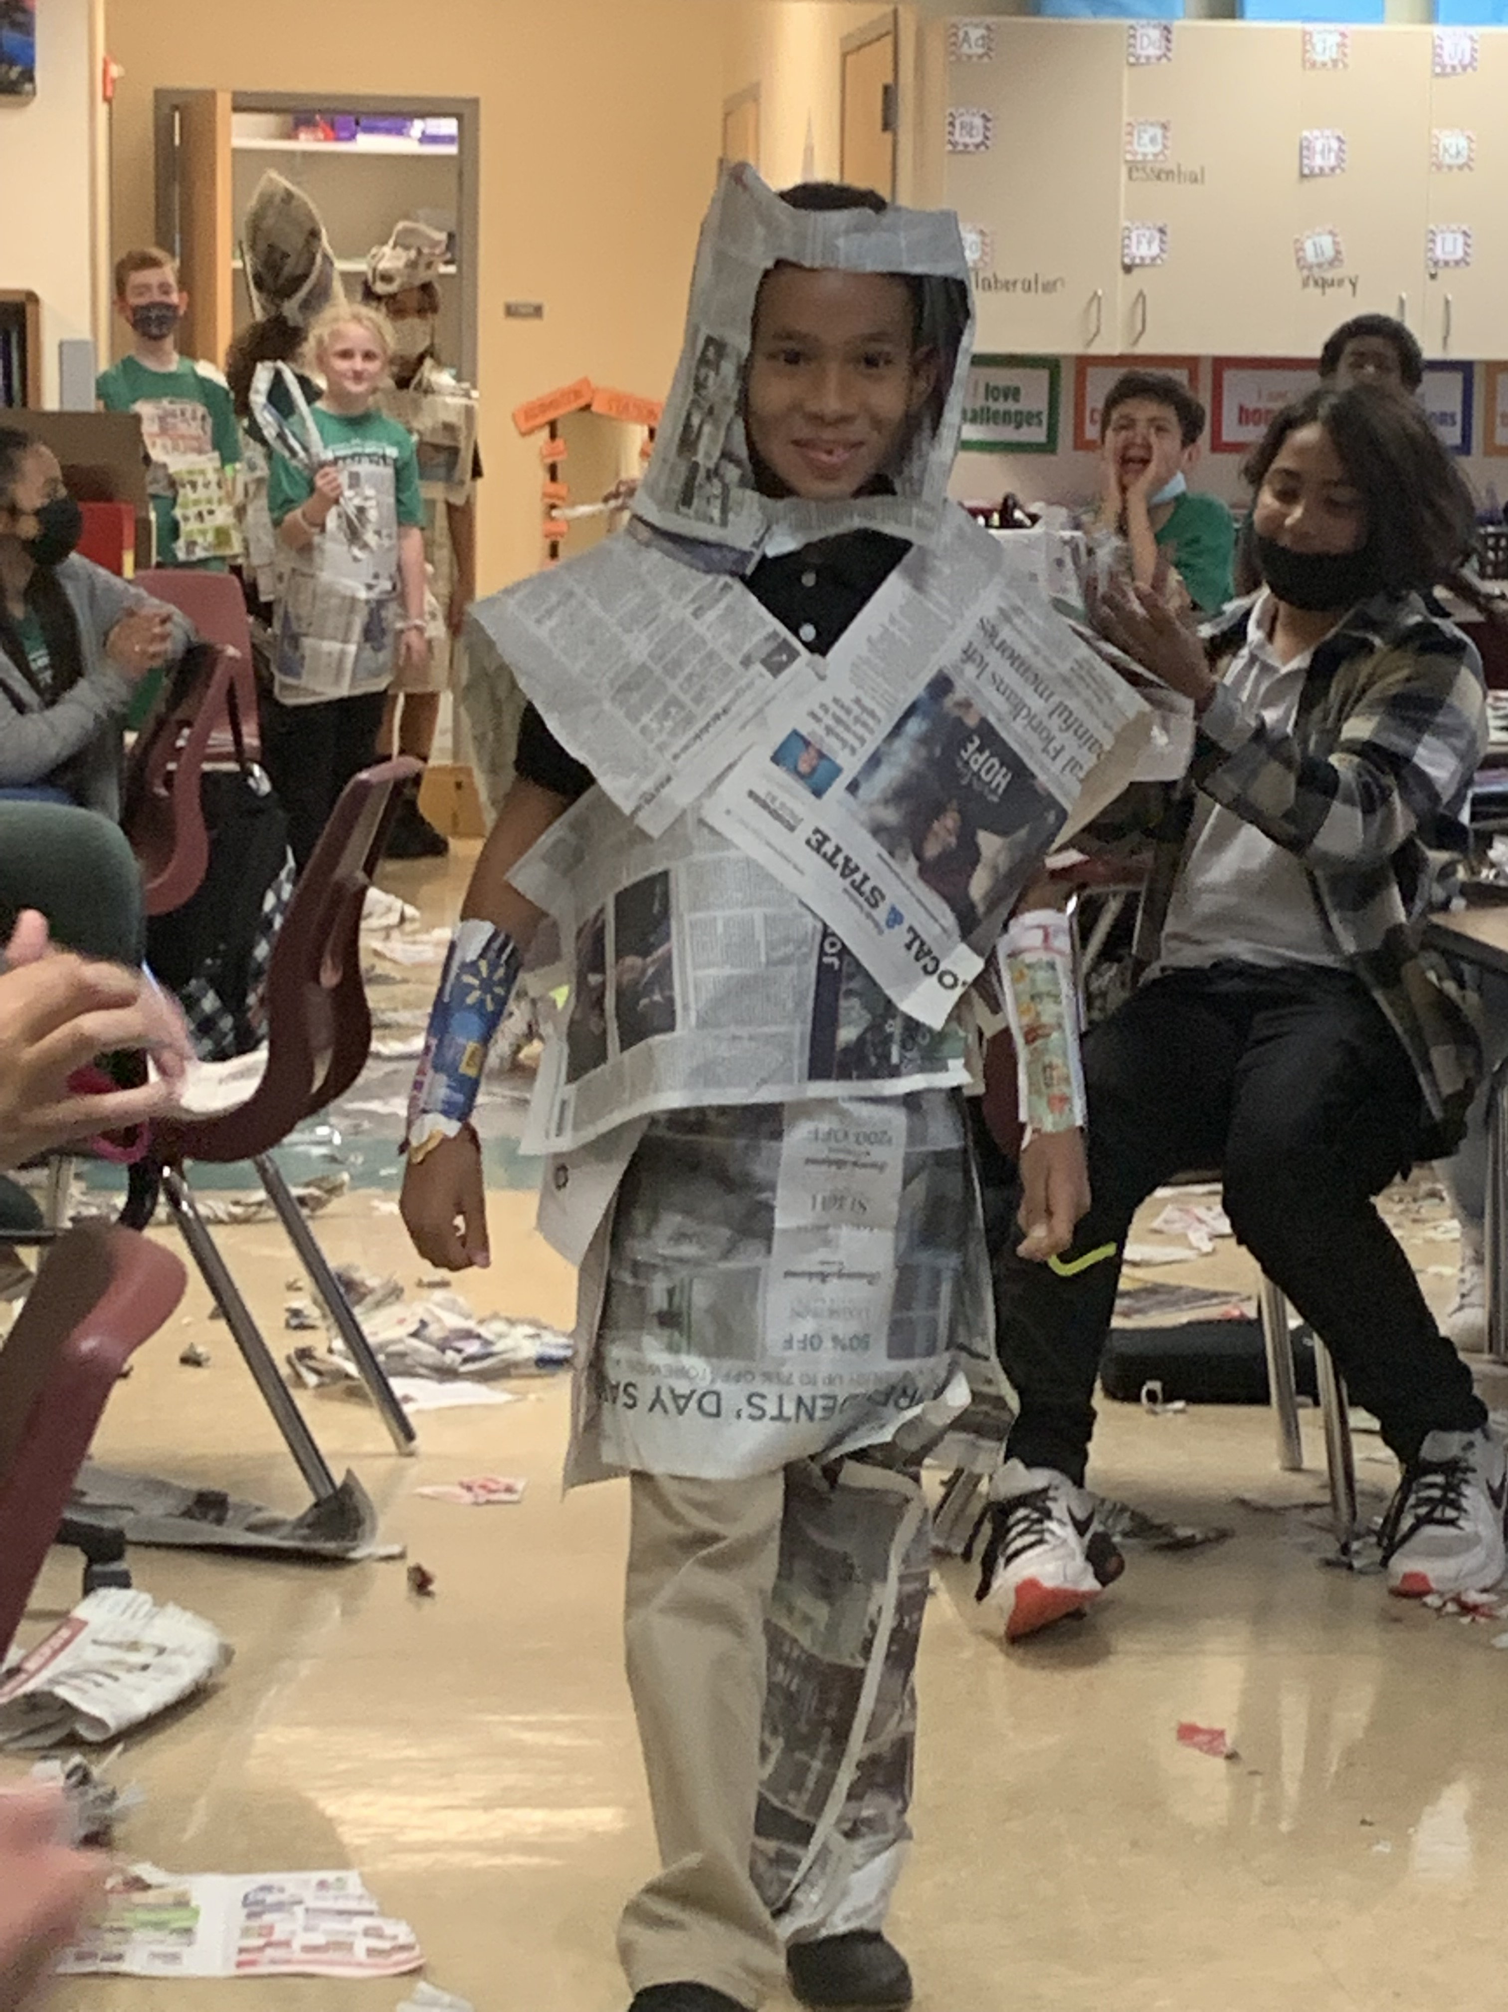
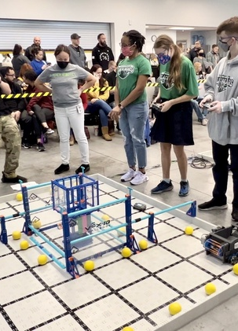
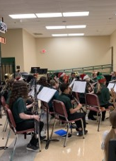
Elective offerings
AVID
Art
Band
Chorus
Computer Applications
Orchestra
PE
STEM (Design and Modeling)
Spanish
Theatre/Musical Theatre

Slide 10




AVID – Full Year
Advancement Via Individual Determination
  Must complete an application
  Learn how to be college ready
  Organizational skills
  Study skills
  Note taking strategies

Slide 11
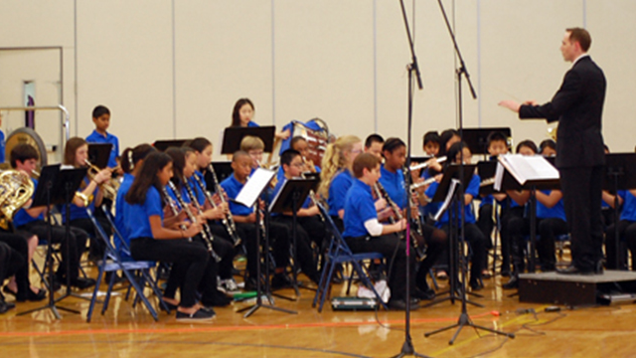
Band – Full Year
  To learn a new instrument
  May need to rent or purchase an instrument
  Need to practice the instrument at home
  Students will preform in Winter and Spring concerts

Slide 12
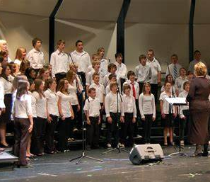
Chorus – Full Year
  Basic vocal Music Instruction (Sing)
  Will perform in winter and spring concerts

Slide 13
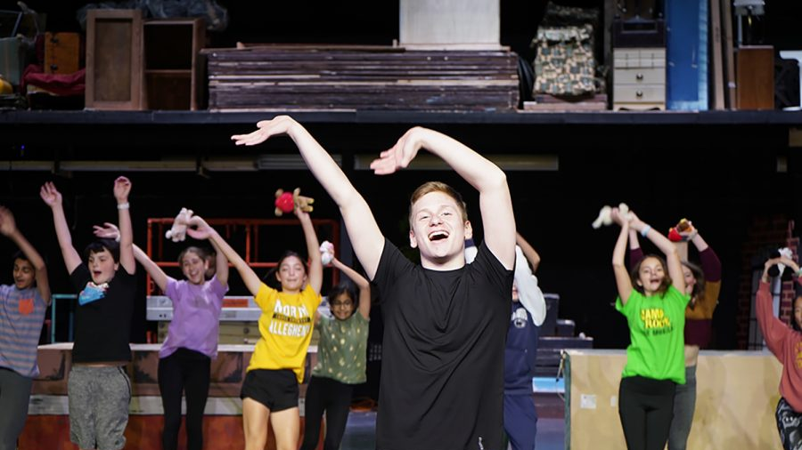
Musical Theatre – Full Year
  Explores basic acting
  Basic vocal performances
  Basic dance/movement and staging

Slide 14
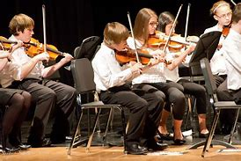
Orchestra – Full Year
  Need to learn a new instrument
  May need to rent or purchase an instrument
  Need to practice the instrument at home
  Students will preform in Winter and Spring concerts

Slide 15
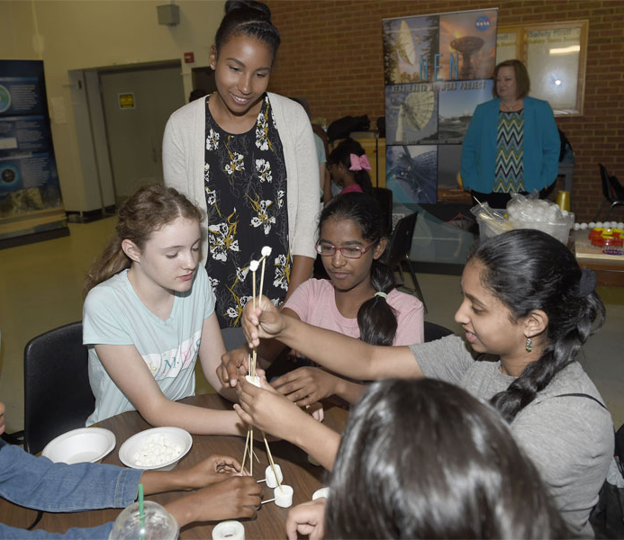
6th Grade STEM – Full Year
  Will cover engineering design and science behind technology
  Can take Robotics in 7th or 8th grade

Slide 16
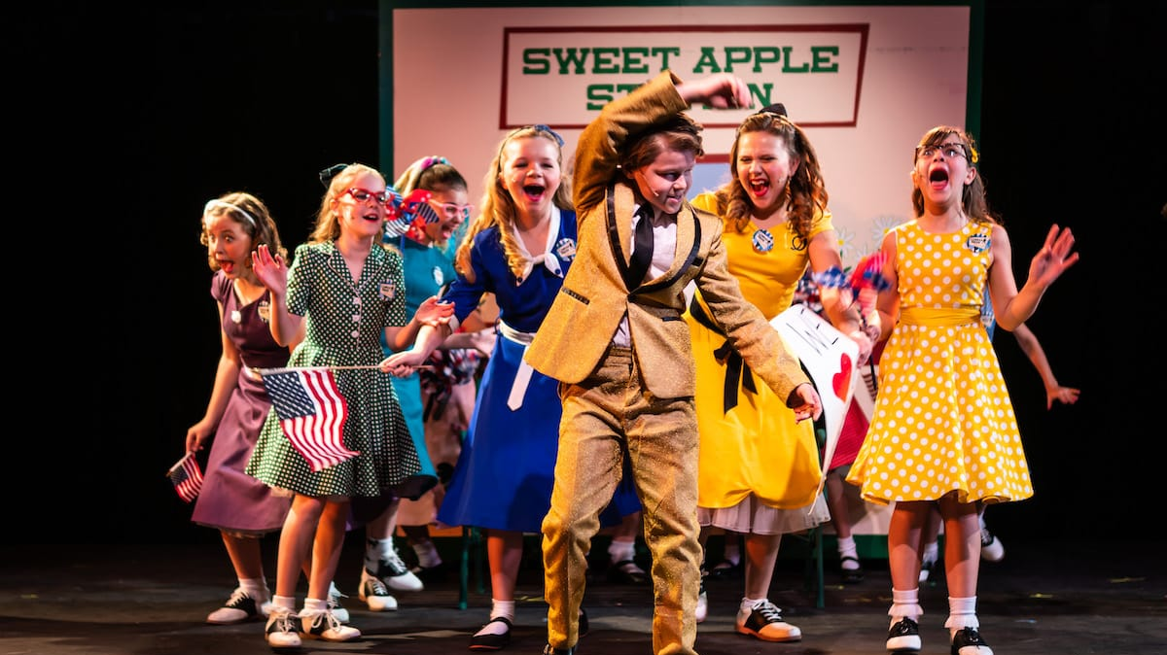
Acting/Drama Half Year
  Explores theatre’s social and cultural influences
  Performance in front of peers
  Memorizing lines

Slide 17
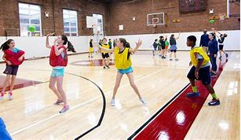
Physical Education Half Year
  Active participation course which demonstrates wide variety of skills.
  Must purchase uniform and dress out each day.

Slide 18
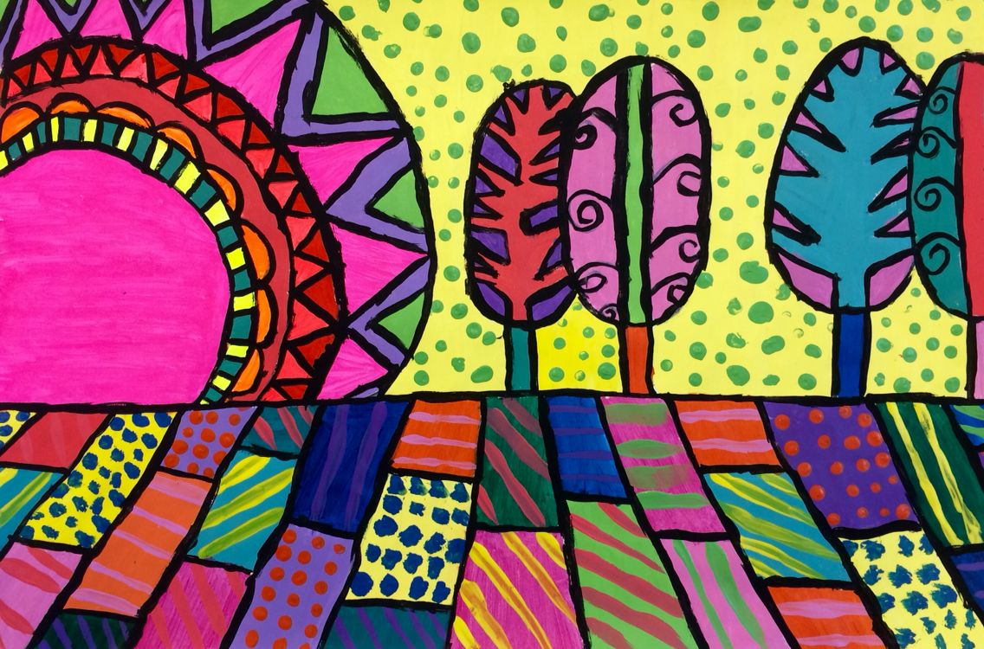
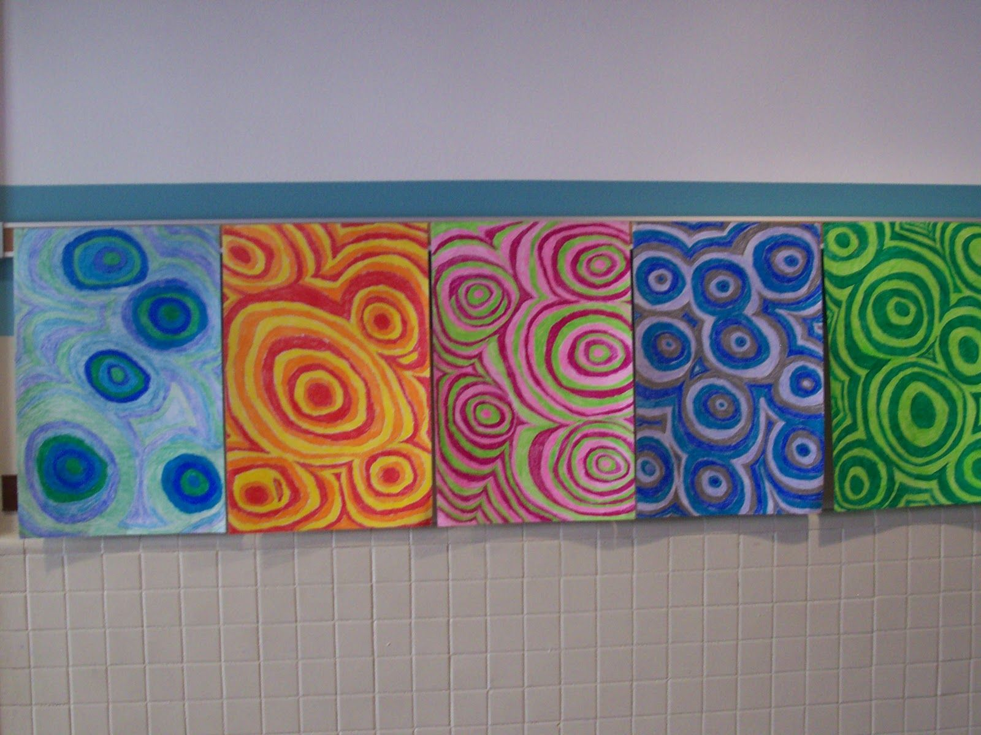
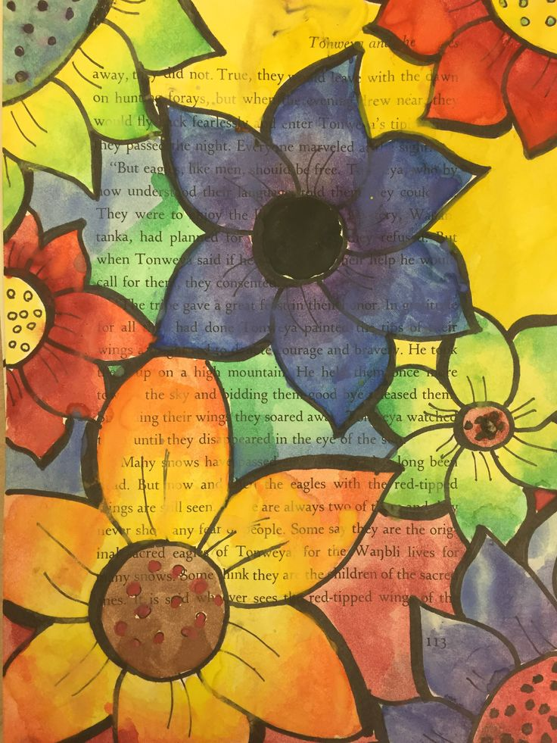
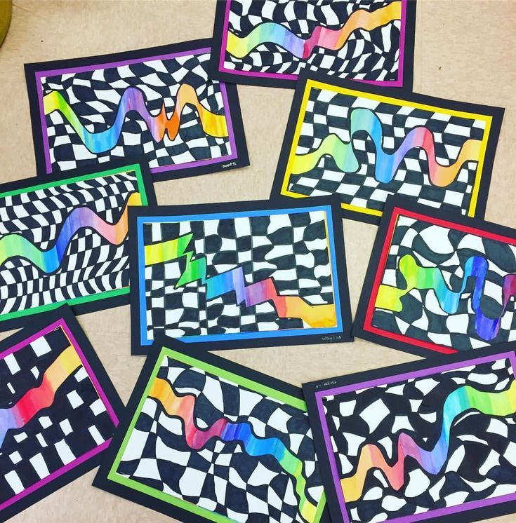
Visual Art - Half Year
  Basic art
  Learn different techniques
  Different brushes
  Color patterns
  Be creative

Slide 19
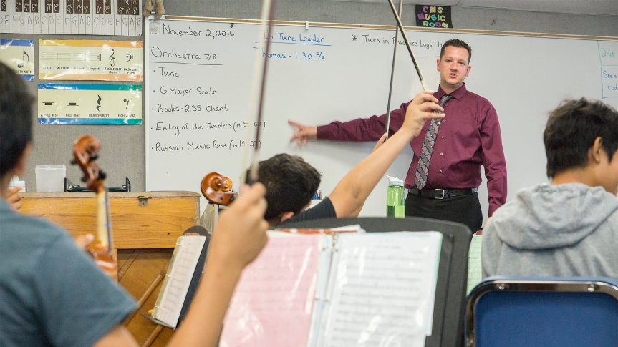
Understanding Music - Half Year
  Basic Musical knowledge
  No instrument required
  Learn about music
  Writing music
  Perform in front of peers

Slide 20

Exploratory Spanish - Half Year
    Basic Spanish
    Not High School credit

Slide 21
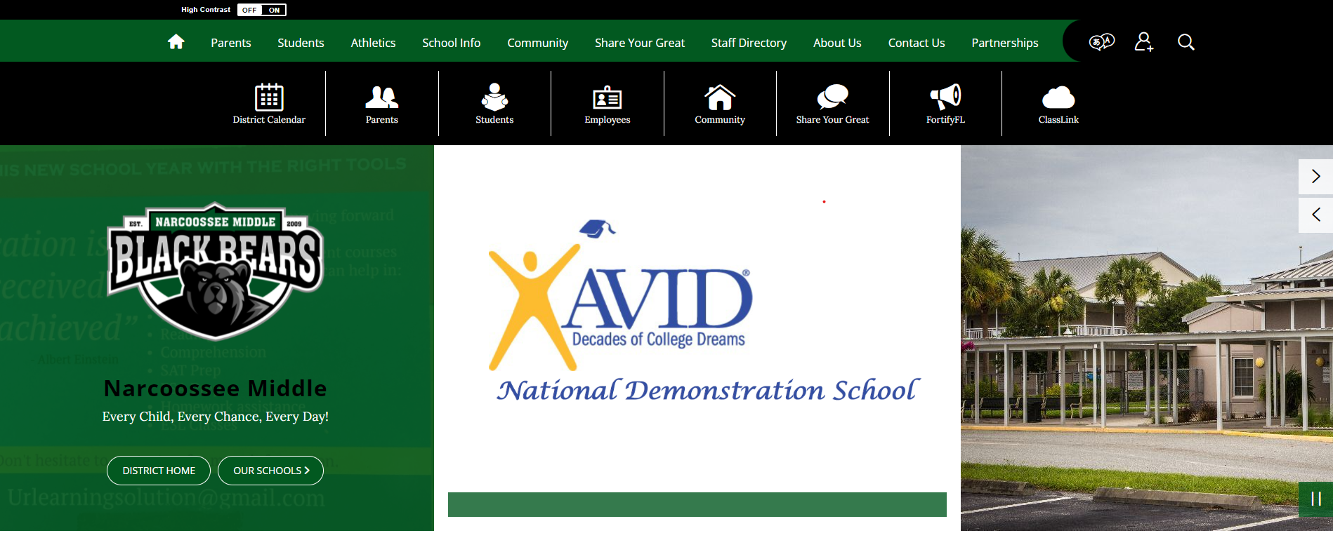
NCMS Website--osceolaschools.net/ncms

Slide 22
osceolaschools.net/ncms

